Slide 1
Deep Q-Network (DQN)

Slide 2
Was kann DQN?

Slide 3
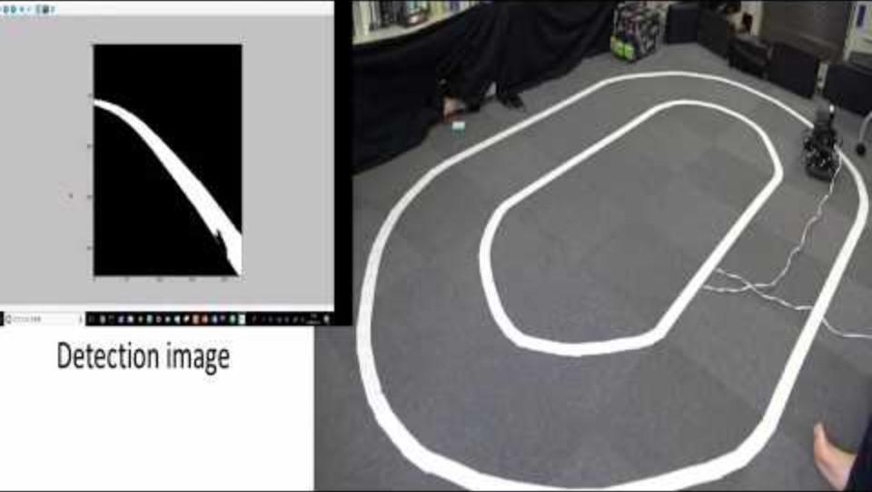

Slide 4
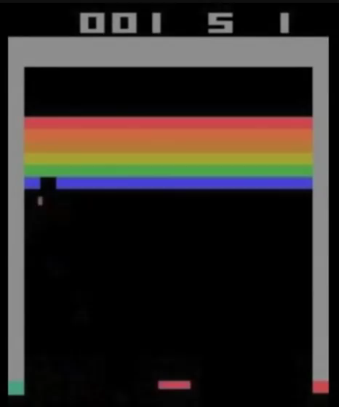
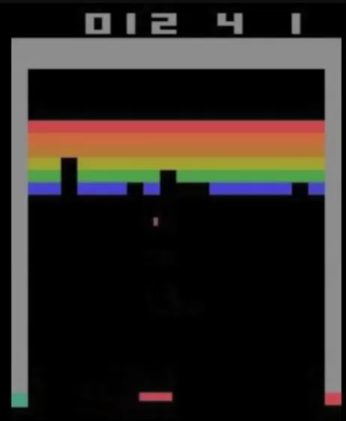
Breakout

Slide 5
Was ist DQN?

Slide 6
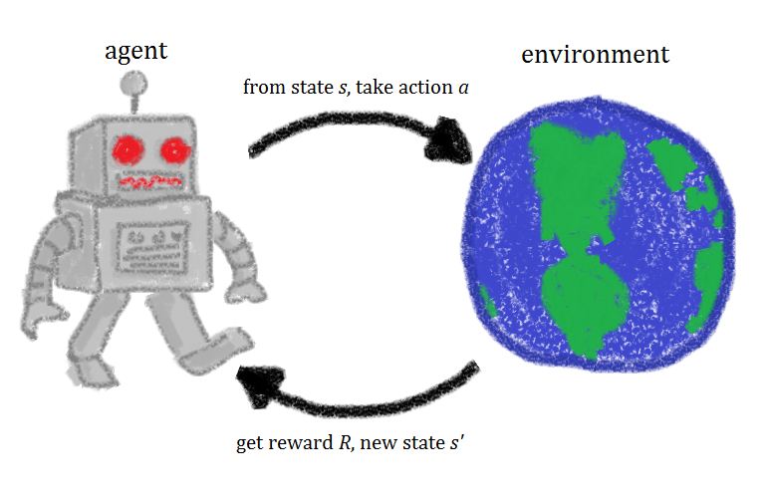
Agent-Environment Loop
Agent perceives the state of the environment
Agent takes an action
Environment transitions to a new state
Environment provides a reward to the agent

Slide 7
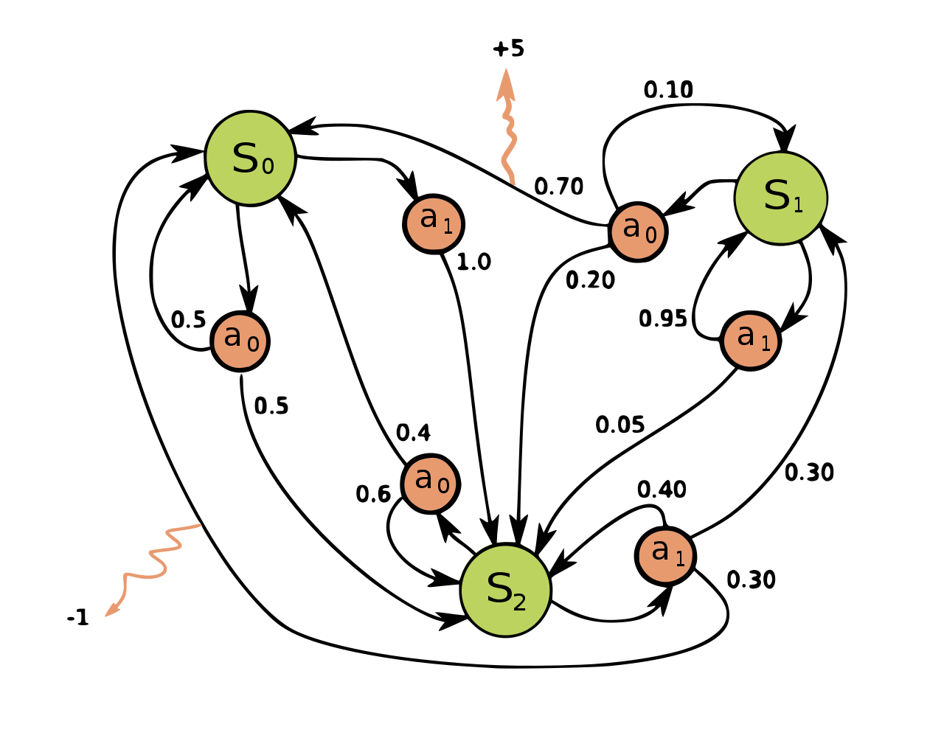
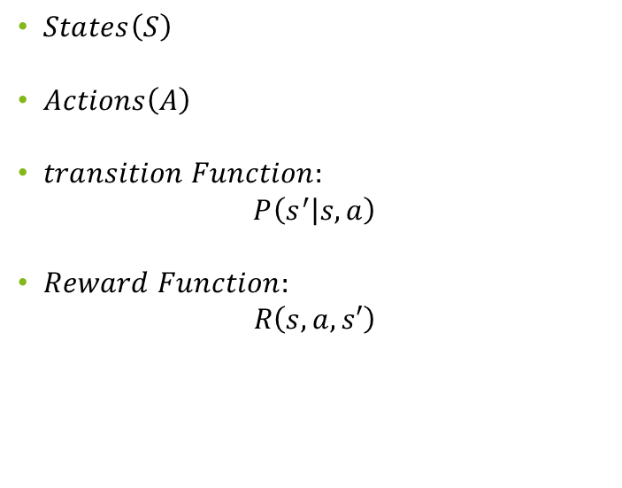
Markov Decission Process..
$States\left(S\right)$
$Actions\left(A\right)$
$transition Function:$
$$P\left(s^{′} | s,a\right)$$
$Reward Function:$
$$R\left(s,a,s′\right)$$

Slide 8
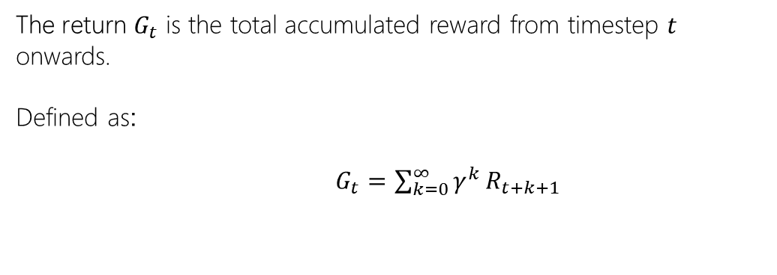
.. and its return
The return $G_{t}$ is the total accumulated reward from timestep $t$ onwards.
Defined as:
$G_{t}=\sum_{k=0}^{∞}{γ^{k}}R_{t+k+1}$

Slide 9
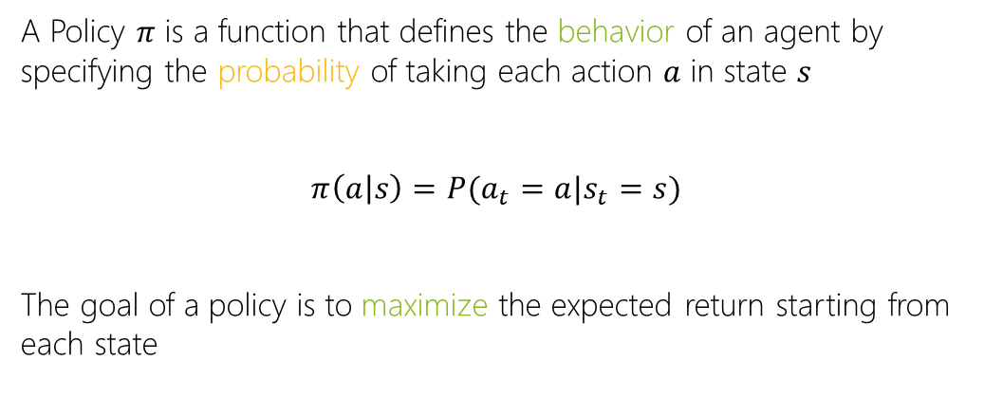
Policy
A Policy $π$ is a function that defines the behavior of an agent by specifying the probability of taking each action $a$ in state $s$
$$π\left(a | s\right)=P(a_{t}=a|s_{t}=s)$$
The goal of a policy is to maximize the expected return starting from each state

Slide 10
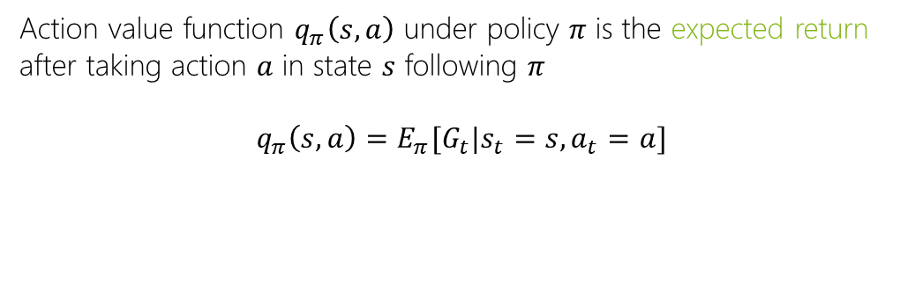
Action value function
Action value function $q_{π}\left(s,a\right)$ under policy $π$ is the expected return after taking action $a$ in state $s$ following $π$
$$q_{π}\left(s,a\right)=E_{π}[G_{t}|s_{t}=s,a_{t}=a]$$

Slide 11
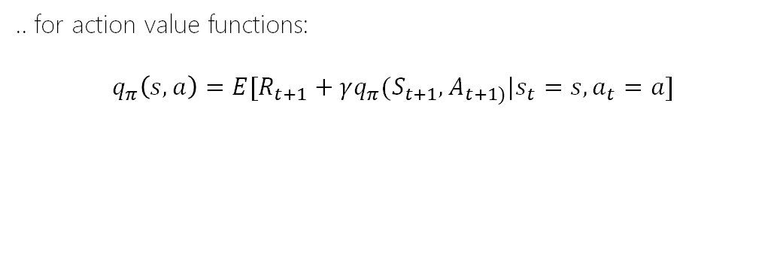
Bellman‘s expectation equation..
.. for action value functions:
$$q_{π}\left(s,a\right)=E[R_{t+1}+γq_{π}(S_{t+1},A_{t+1)}|s_{t}=s,a_{t}=a]$$

Slide 12
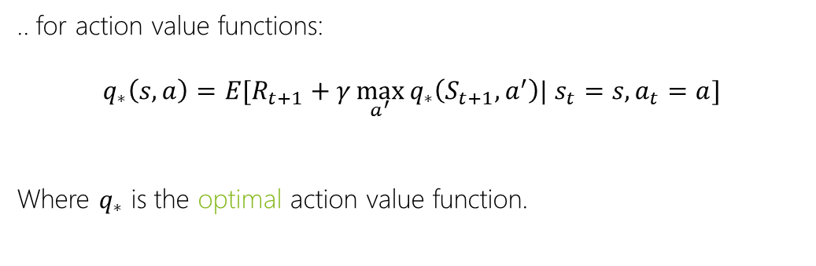
Bellman‘s optimality equation..
.. for action value functions:
$$q_{∗}\left(s,a\right)=E[R_{t+1}+γ\max_{a^{′}}{q_{∗}\left(S_{t+1},a^{′}\right)| s_{t}=s, a_{t}=a]}$$
Where $q_{∗}$ is the optimal action value function.

Slide 13
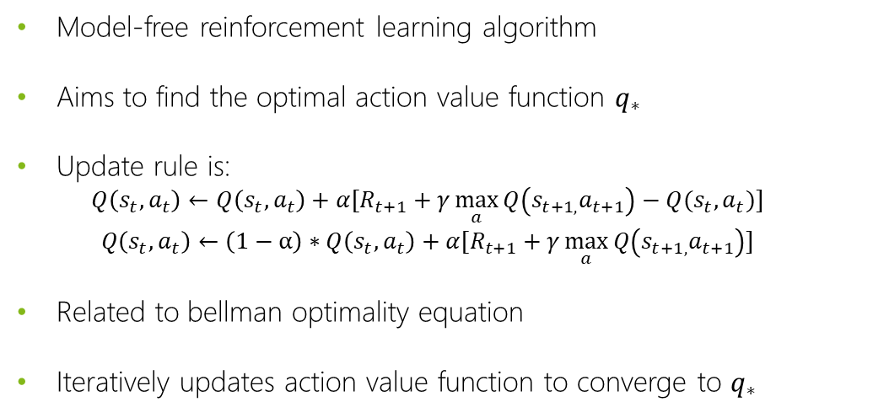
Q-Learning
Model-free reinforcement learning algorithm
Aims to find the optimal action value function $q_{∗}$
Update rule is:
$${Q\left(s_{t},a_{t}\right)←Q\left(s_{t},a_{t}\right)+α[R}_{t+1}+γ\max_{a}{Q\left(s_{t+1,}a_{t+1}\right)−Q(s_{t},a_{t})]}$$
$${Q\left(s_{t},a_{t}\right)←\left(1−α\right)∗Q\left(s_{t},a_{t}\right)+α[R}_{t+1}+γ\max_{a}{Q\left(s_{t+1,}a_{t+1}\right)]}$$
Related to bellman optimality equation
Iteratively updates action value function to converge to $q_{∗}$

Slide 14
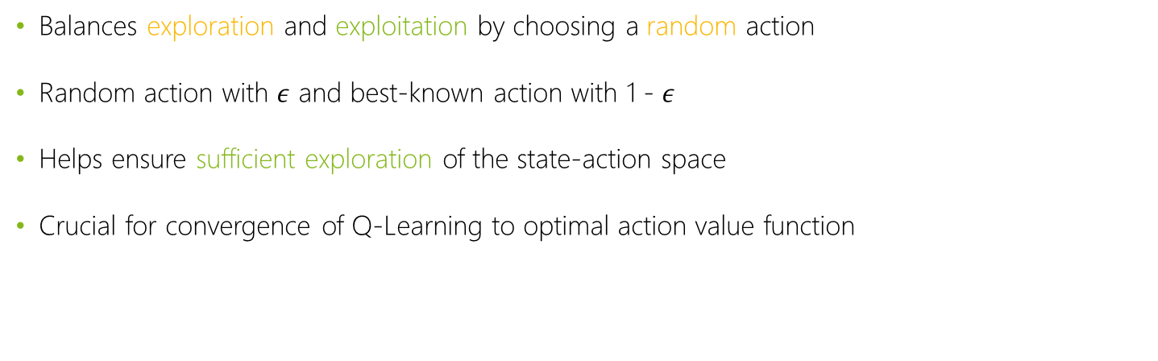
Epsilon-Greedy Policy
Balances exploration and exploitation by choosing a random action
Random action with $ε$ and best-known action with 1 - $ε$
Helps ensure sufficient exploration of the state-action space
Crucial for convergence of Q-Learning to optimal action value function

Slide 15
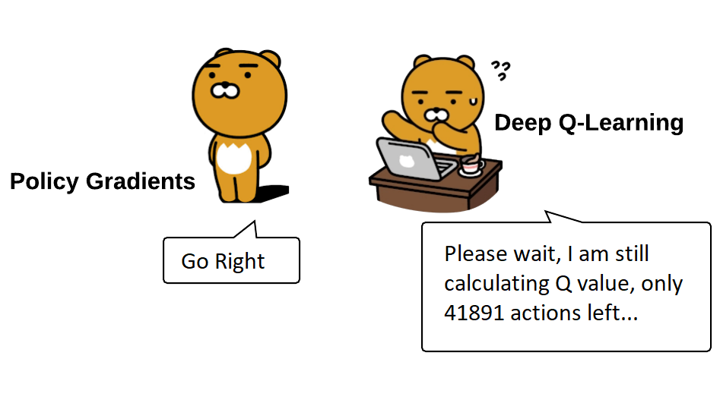
Einführung in das Deep Q Learning

Slide 16
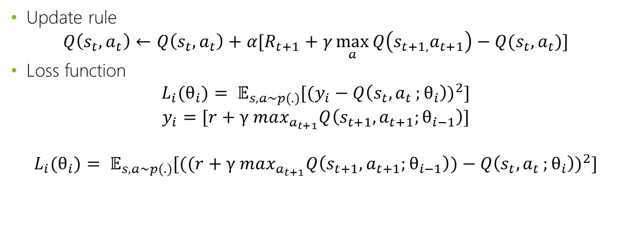
update rule & loss function
Update rule
$${Q\left(s_{t},a_{t}\right)←Q\left(s_{t},a_{t}\right)+α[R}_{t+1}+γ\max_{a}{Q\left(s_{t+1,}a_{t+1}\right)−Q(s_{t},a_{t})]}$$
Loss function
$$L_{i}{(θ}_{i})= 𝔼_{s,a∼p(.)}[(y_{i}−Q\left(s_{t}{,a}_{t};θ_{i}\right))^{2}]$$
$$y_{i}=[r+γ max_{a_{t+1}}Q\left(s_{t+1},a_{t+1};θ_{i−1}\right)]$$
$$L_{i}(θ_{i})= 𝔼_{s,a∼p(.)}[((r+γ max_{a_{t+1}}Q\left(s_{t+1},a_{t+1};θ_{i−1}\right))−Q\left(s_{t}{,a}_{t};θ_{i}\right))^{2}]$$

Slide 17
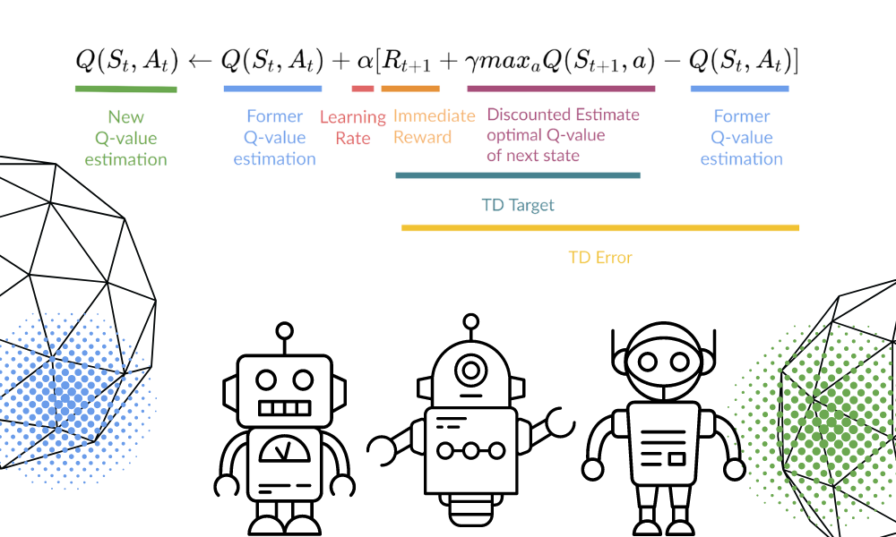
Update rule a closer look!

Slide 18
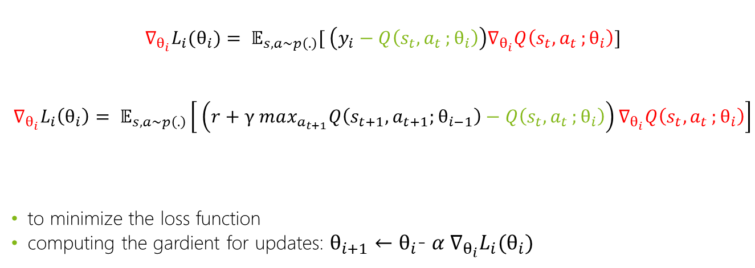
Gardient
$$∇_{θ_{i}}L_{i}(θ_{i})= 𝔼_{s,a∼p\left(.\right)}[ \left(y_{i}−Q\left(s_{t}{,a}_{t};θ_{i}\right)\right)∇_{θ_{i}}Q\left(s_{t}{,a}_{t};θ_{i}\right)]$$
$$∇_{θ_{i}}L_{i}\left(θ_{i}\right)= 𝔼_{s,a∼p\left(.\right)}\left[ \left(r+γ max_{a_{t+1}}Q\left(s_{t+1},a_{t+1};θ_{i−1}\right)−Q\left(s_{t}{,a}_{t};θ_{i}\right)\right)∇_{θ_{i}}Q\left(s_{t}{,a}_{t};θ_{i}\right)\right]$$
to minimize the loss function
computing the gardient for updates: $θ_{i+1}$ $←$ $θ_{i}$- $α ∇_{θ_{i}}L_{i}(θ_{i})$

Slide 19
Experience Replay
Memory of experiences
Pick of minibatches for update of the Q-function
Adresses three issues:
Data Efficiency
Low Correlation
Catastrohic forgetting

Slide 20
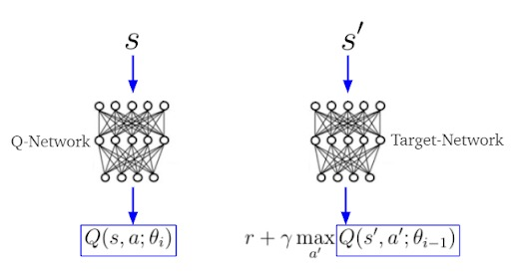
Target Q-Network

Slide 21
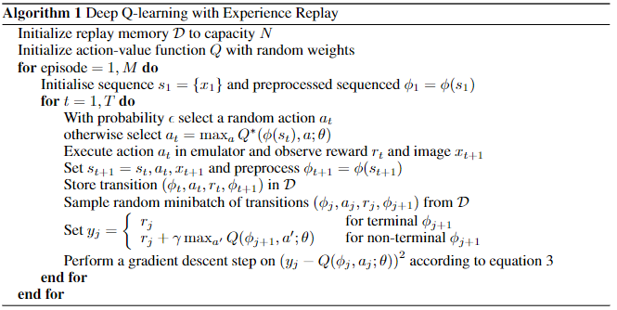
DQN Pseudocode

Slide 22
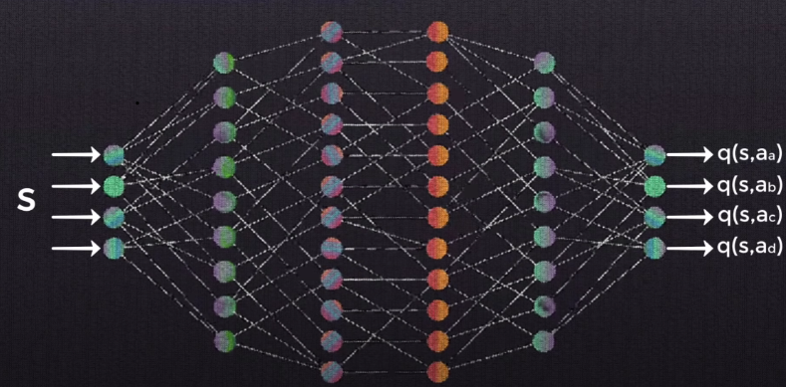
Neuronal Network
Q-function » Q-network » neuronnal network
Weights of q-learning are weights for neuronal network
Layers: input (states), hidden (convulational layers), output (q-values for each action)
https://youtu.be/xVkPh9E9GfE

Slide 23
Preprocessing of game frames
Grayscale
Downsampling to 110x84
Crop to 84x84
Stack 4 frames to one

Slide 24
Reward Clipping
limit the reward to interval [-1,1]
High rewards are counterproductive for strabelized learning
Clipping stabelizes learning

Slide 25
Performance Metrics
Within a specific time periode
Average and maximum points

Slide 26
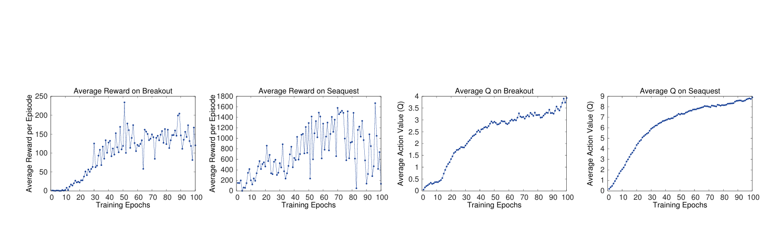
Results from the Paper

Slide 27
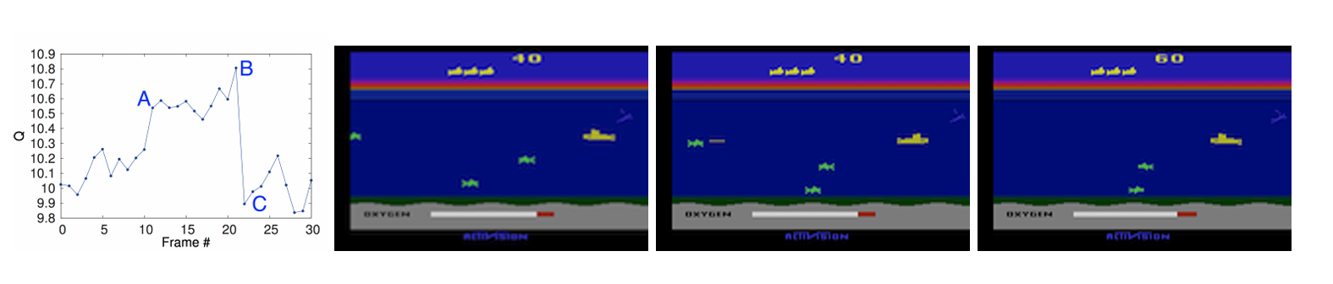
Results from the Paper

Slide 28
How to implement
Classes:
Agent Class (DQNAgent):
Responsible for controlling the DQN agent.
Methods:
select_action: Selects actions based on the current state.
train: Trains the agent using experiences stored in the replay memory.
update_target_network: Updates the target network periodically.

Slide 29
How to implement
Classes:
Neural Network Class (DQN):
Defines the neural network architecture for approximating Q-values.
Methods:
__init__: Initializes the network with state_size and action_size.
forward: Performs forward pass computation.
compute_loss: Computes the loss between predicted and target Q-values.
backward: Performs gradient descent.

Slide 30
How to implement
Classes:
Replay Memory Class:
Manages the replay memory buffer.
Methods:
add_experience: Adds experiences to the replay memory.
sample_batch: Samples batches of experiences for training.

Slide 31
Links / Sources
Picture Roboter & World :
https://commons.wikimedia.org/wiki/File:Rl_agent.png
Markov decision process: https://upload.wikimedia.org/wikipedia/commons/thumb/a/ad/Markov_Decision_Process.svg/1280px-Markov_Decision_Process.svg.png
Update rule: https://images.datacamp.com/image/upload/v1666973295/Q_learning_equation_3cd6652b98.png
Policy bears:
https://pylessons.com/media/Tutorials/Reinforcement-learning-tutorial/Beyond-DQN/Beyond-DQN.jpg
Target Q-network :
https://builtin.com/sites/www.builtin.com/files/styles/ckeditor_optimize/public/inline-images/4_double-deep-q-learning.png
Results from the paper:
Volodymyr Mnih, Koray Kavukcuoglu, David Silver, Alex Graves, Ioannis Antonoglou, Daan Wierstra, Martin Riedmiller, Playing atari with deep reinforcement learning (2013), https://arxiv.org/pdf/1312.5602

Slide 32
Thank you for your attention :)

